Slide 1
Introduction to Testing
The code

Slide 2
Contents
Objectives
Look at the main testing framework used in Java and C# development
Contents
JUnit
How to set up and run
Annotations
NUnit for .NET

Slide 3
Arrange
Set the starting conditions
Act
Invoke the method (or property) that is being tested
Assert
Decide if the test has passed or failed
Test Structure

Slide 4
“Family” of testing frameworks
JUnit for Java, NUnit and MSTest for .NET, Test::Unit for Perl
Simple framework with common design to organise and run tests
Setup, Test, Assertion, Tear Down
Essential for support of Extreme Programming & Test Driven Development
What is xUnit?

Slide 5
JUnit test method for Java

Slide 6
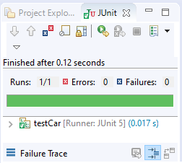
How to create a test?
Right click on the package name and select
New > Other > JUnit > JUnit test case
Select the CUT in the dialog and then write code:
Run the code
import static org.junit.jupiter.api.Assertions.*;
import org.junit.jupiter.api.Test;
class testCar {
@Test
void testCarAccelerate() {
Car car = new Car("Ford");
car.accelerate(10);
assertEquals(50, car.getSpeed());
}
}

Slide 7
JUnit @Before and @After annotations
class testCar {
Car car;
@BeforeEach
public void setUp() {
car = new Car("Ford");
}
@AfterEach
public void tearDown() {
car = null;
}
@Test
void testCarAccelerate() {
System.out.println("@test");
car.accelerate(10);
assertEquals(50, car.getSpeed());
}
}
Marks method to run before each @Test
Marks method to run after each @Test

Slide 8
JUnit Assertion methods 2
assertSame() – identity of reference (Are they the same objects?)
assertNotSame()
assertTrue() – check Boolean value
assertFalse()
assertNull() – check if an object is null
assertNotNull()
Fail method
fail()
fail(String message)
Notes:
assertSame()/assertNotSame() will determine if two objects refer to the same object.

Slide 9
DateTimeException
DateTimeException
JUnit Testing expected Exceptions
And
Timeouts
@Test marks method as a unit test
@Test(expected = Exception.class)
Will fail if the method does not throw the expected exception
@Test(expected = DateTimeException.class)
@Test(timeout = 200)
Will fail if the method takes longer than 200 milliseconds

Slide 10
Unit testing method for .NET

Slide 11
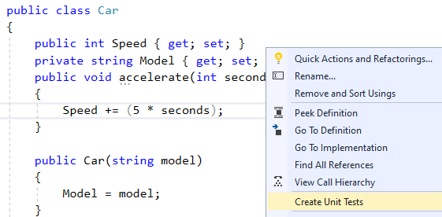
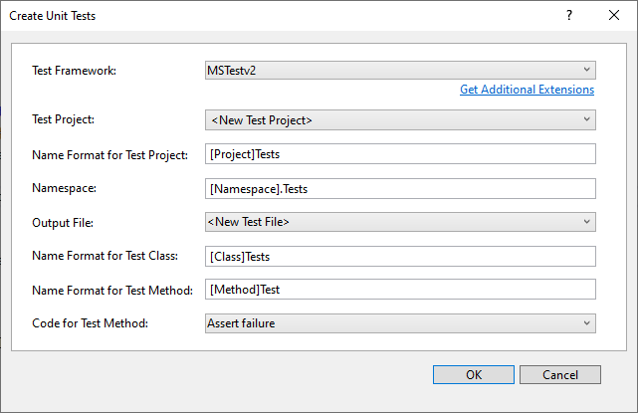
Create a MS-Test project
Right mouse click on a method and then create a unit test project

Slide 12
Write test code
[TestClass()]
public class CarTests {
Car car;
[TestInitialize]
public void SetUp() {
car = new Car("Ford");
}
[TestCleanup]
public void TearDown() {
car = null;
}
[TestMethod()]
public void accelerateTest() {
car.accelerate(10);
Assert.AreEqual(50, car.Speed);
}
}

Slide 13
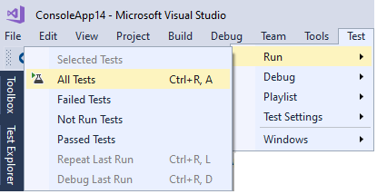
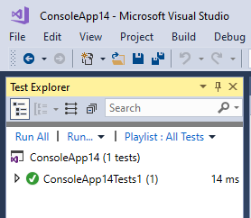
Run the tests

Slide 14
Testing Expected Exceptions with MS-Test
The following test succeeds if null values entered as username
The Login() constructor throws exception
We test that exception is thrown
[TestMethod]
[ExpectedException(typeof(ArgumentException))]
public void TestNullUsername()
{
LogonInfo login = new Login(null, "password123");
}

Slide 15
Unit Testing and Test Driven Development are the recommended approach to produce quality software
JUnit and MS-Test encourages the TDD mindset
Review

